Slide 1
Mobile Robot Forward Kinematics

Slide 2
Forward Kinematics : Differential Drive
what is the position of the ICC in {W}?
V
θ
{W}

Slide 3
Forward Kinematics : Differential Drive
V
θ
{W}

Slide 4
Forward Kinematics : Differential Drive
assuming smooth rolling motion at each point in time the differential drive is moving in a circular path centered on the ICC
  thus, for a small interval of time δt the change in pose can be computed as a rotation about the ICC
ICC
R
P(t+δt)
P(t)

Slide 5
Forward Kinematics : Differential Drive
computing the rotation about the ICC
  translate so that the ICC moves to the origin of {W}
  rotate about the origin of {W}
  translate back to the original ICC
ICC
R
P(t+δt)
P(t)

Slide 6
Forward Kinematics : Differential Drive
computing the rotation about the ICC
  translate so that the ICC moves to the origin of {W}
  rotate about the origin of {W}
  translate back to the original ICC

Slide 7
Forward Kinematics : Differential Drive
computing the rotation about the ICC
  translate so that the ICC moves to the origin of {W}
  rotate about the origin of {W}
  translate back to the original ICC
how much rotation over the time interval?
  angular velocity * elapsed time =

Slide 8
Forward Kinematics : Differential Drive
computing the rotation about the ICC
  translate so that the ICC moves to the origin of {W}
  rotate about the origin of {W}
  translate back to the original ICC

Slide 9
Forward Kinematics : Differential Drive
what about the orientation ?
  just add the rotation for the time interval
new pose
which can be written as

Slide 10
Forward Kinematics: Differential Drive
the previous equation is valid if
  i.e., if the differential drive is not travelling in a straight line
if then

Slide 11
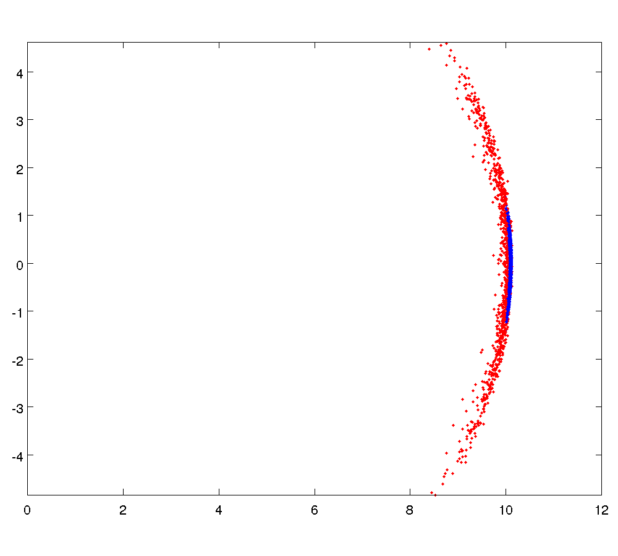
Sensitivity to Wheel Velocity
σ = 0.05
σ = 0.01

Slide 12
Sensitivity to Wheel Velocity
given the forward kinematics of the differential drive it is easy to write a simulation of the motion
  we need a way to draw random numbers from a normal distribution
  in Matlab
    randn(n) returns an n-by-n matrix containing pseudorandom values drawn from the standard normal distribution
    see mvnrnd for random values from a multivariate normal distribution

Slide 13
Sensitivity to Wheel Velocity
POSE = []; % final pose of robot after each trial
sigma = 0.01; % noise standard deviation
L = 0.2; % distance between wheels
dt = 0.1; % time step
TRIALS = 1000; % number of trials
for trial = 1:TRIALS
end
-run each trial-
see next slide

Slide 14
Sensitivity to Wheel Velocity
vr = 1; % initial right-wheel velocity
vl = 1; % initial left-wheel velocity
pose = [0; 0; 0]; % initial pose of robot
for t = 0:dt:10
end
POSE = [POSE pose]; % record final pose after trial t
-move the robot one time step -
see next slide

Slide 15
Sensitivity to Wheel Velocity
theta = pose(3);
if vr == vl
pose = pose + [vr * cos(theta) * dt;
vr * sin(theta) * dt;
0];
else
omega = (vr – vl) / L;
R = (L / 2) * (vr + vl) / (vr – vl);
ICC = pose + [-R * sin(theta);
R * cos(theta);
0];
pose = rz(omega * dt) * (pose – ICC) + ICC +
[0; 0; omega * dt];
end
vr = 1 + sigma * randn(1);
vl = 1 + sigma * randn(1);

